Slide 1
Preparing for the future: the role of mathematical modelling
Gabriele Kaiser University of Hamburg
Convenor ICME-13

Slide 2
Structure
Theoretical frame: Understanding of mathematical modelling, modelling examples, modelling cycle and modelling competencies
Promotion of modelling competencies: various organisational forms
Related important approaches: Numeracy or mathematical literacy as important concepts for emergency preparedness education

Slide 3
The world is currently facing many problems:
Social problems such as economical inequality, limited access to water, food, … of huge parts of the world population, illiteracy of many adults and children, limited access to education for many children …..
Environmental problems such as problems caused by earth quakes, volcanos, Tsunamis, flooding, fire …..
What can mathematical education contribute to the solution of these problems (theme of this conference) ?
What can mathematical modelling contribute to being prepared for these problems?

Slide 4
1. Theoretical framework

Slide 5
Ubiratan D’Ambrosio in “ZDM – The International Journal on Mathematics Education”, issue 1-2 in 2007:
“We find, in every civilization and in all the times, some form of education. From initiation practices through complex educational systems, the major goals are always:
to promote creativity, helping people to fulfill their potentials and raise to the highest of their capability, but being careful not to promote docile citizens. We do not want our students to become citizens who obey and accept rules and codes which violate human dignity.
to promote citizenship transmitting values and showing rights and responsibilities in society, but being careful not to promote irresponsible creativity. We do not want our student to become bright scientists creating new weaponry and instruments of oppression and inequity.”

Slide 6
Central aim of mathematical modelling:
to answer the questions
why shall children learn mathematics and
how can we enable children to use mathematics in order to solve real world problems or more specific (for APEC) to use mathematics in emergency situations

Slide 7
Milestone for recent international initiatives for implementing modelling approaches in mathematics education:
Hans Freudenthal’s Symposium “How to teach mathematics so as to be useful” in 1968, ICME-1, in Exeter, proceedings published as first volume of Educational Studies in Mathematics in 1969.
In his welcome speech, “Why to teach mathematics so as to be useful”, Freudenthal made a strong plea to change mathematics education, to include real world examples and modelling into mathematics education in order to make mathematics more meaningful for students. The connection to real life, mathematizing the world, was important for him.
He criticises the usual teaching approaches, unfortunately still common in many classrooms until today:

Slide 8
“There are two extreme attitudes: to teach mathematics with no other relation to its use than the hope that students will be able to apply it whenever they need to. If anything, this hope has proved idle. The huge majority of students are not able to apply their mathematical classroom experiences, neither in the physics or chemistry school laboratory nor in the most trivial situations of daily life. The opposite attitude would be to teach useful mathematics. … that this is not what I mean when speaking about mathematics being taught to be useful. The disadvantage of useful mathematics is that it may prove useful as long as the context does not change, and not a bit longer, and this is just the contrary of what true mathematics should be. Indeed it is the marvellous power of mathematics to eliminate the context, and to put the remainder into a mathematical form in which it can be used time and again.”

Slide 9
He concludes:
”I am convinced that, if we do not succeed in teaching mathematics so as to be useful, users of mathematics will decide that mathematics is too important a teaching matter to be taught by the mathematics teacher. Of course this would be the end of all mathematical education.”

Slide 10
What does it mean to teach mathematics so as to be useful, to teach mathematics in such a way that students can use it in order to solve real world problems?
Currently accepted approach (not the only one) to answer these questions is the modelling approach:
What do we mean by mathematical modelling?
Using mathematics in order to solve real world problems with mathematical methods.
Learning modelling means: develop students’ competencies to use their mathematics for the solution of problems of their daily life and from sciences
Relation between mathematics and reality is important, going back and forth.
Modelling is an activity, a process.

Slide 11
Overview on the current debate
14th ICMI Study on Modelling and Applications in Mathematics Education
Edited by Werner Blum, Peter Galbraith, Hans-Wolfgang Henn, Mogens Niss
New York: Springer, 2007.

Slide 12
What do we want to achieve - goals of modelling in mathematics education
Different classifications for goals of modelling in mathematics education (e.g. Kaiser-Meßmer, 1986, Blum 1995):
Pedagogical goals: imparting abilities that enable students to understand central aspects of our world in a better way;
Psychological goals: fostering and enhancement of the motivation and attitude of learners towards mathematics and mathematics teaching;
Subject-related goals: structuring of learning processes, introduction of new mathematical concepts and methods including their illustration;
Science-related goals: imparting a realistic image of mathematics as science and into the historical relation of mathematics and its applications, supporting of critical reflections about the usage of mathematics in real world contexts.

Slide 13
Different international perspectives on modelling
Name of the perspective | Central aims | Background
Realistic or applied modelling | Pragmatic-utilitarian goals, i.e.: solving real world problems, under­standing of the real world, promotion of modelling competencies | Anglo-Saxon pragmatism and applied mathematics
Contextual modelling | Subject-related and psychological goals, i.e. solving word problems | American problem solving debate as well as everyday school practice and psychological laboratory experiments

Slide 14
Name of the perspective | Central aims | Background
Model eliciting approach | Psychological goals, transfer of models elicited to new problem | American problem solving debate
Educational modelling | Pedagogical and subject-related goals: a) Structuring of learning processes and its promotion b) Concept introduction and development | Didactical theories and learning theories

Slide 15
Name of the perspective | Central aims | Background
Socio-critical modelling | Pedagogical goals such as critical understanding of the surrounding world | Socio-critical approaches in political sociology
Epistemological or theoretical modelling | Theory-oriented goals, i.e. promotion of theory development | Romanic epistemology

Slide 16
As kind of meta-perspective
Name of the perspective | Central aims | Background
Cognitive modelling | Two kinds of goals: a) Research aims: analysis of cognitive processes taking place during modelling processes and understanding of these cognitive processes b) Psychological goals: promotion of mathematical thinking processes by using models as mental images or even physical pictures or by emphasising modelling as mental process such as abstraction or generalisation | Cognitive psychology
Open question until now, which perspective most suitable for emercency preparedness.

Slide 17
How do we model?
Several approaches to describe modelling processes
Well accepted are modelling cycles with different stages departing from the real world problem and coming back to its solution via mathematical models

Slide 18
Mathematisation
Real world model
Mathematical model
Understanding
Idealisation
Mathematical work
Validation
Real situation
Validation
Mathematical results
Real results
Interpretation
Real world
Mathematics

Slide 19
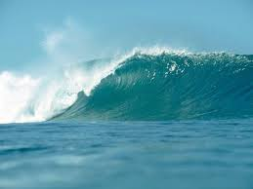
Simple modelling example from emergency preparedness:
We will try and give an easy model for calculating the speed of a Tsunami wave.
The model we use should be suitable for students who are familiar with root functions and basic EXCEL-skills.
This example can be found in: Henning & Freise (Eds.) (2011), Realität und Modell. WTM: Münster, pp. 110-125.

Slide 20
Real situation:
In order to create a model for a single Tsunami wave, one needs to understand the underlying physical principles first, i. e. that the speed of a Tsunami wave is connected to its depth.
In a classroom situation students could use the internet to conduct the necessary information.
The spreadsheet on the right-hand side has been submitted by a geographic research institute (GFZ).
http://www.gitews.org/fileadmin/documents/content/press/GITEWS_Broschuere_DE_08.pdf
Water depth (m) | Speed (kph)
6000 | 800
2000 | 500
500 | 250
200 | 150
100 | 110
20 | 50
10 | 36

Slide 21
Understanding and simplifying…
We need to make a few assumptions to be able to start working.
Assumption 1: We do not take the magnitude of the wave into account as it is relatively small compared to its depth.
Assumption 2: We do not care about friction.
Assumption 3: As the speed of the wave is decreasing the nearer it gets to the surface, we assume that its speed is zero there.

Slide 22
Mathematising…
We want to find a one-dimensional function that uses the depth $h$of the Tsunami wave as an input and gives its speed $v$as an output.
We also find that this function is supposed to be continous, as it could take on any possible (real positive) value.
By using assumption Assumption 3 as well, we have
$$v=f\left(h\right), f\left(0\right)=0.$$

Slide 23
Mathematical working…
In order to plot the graph of the function, we have used the former spreadsheet again but calculated the speed in meters per second. This is the result:

Slide 24
Mathematical working…
We therefore assume a connection that is as in the following equation :
$$v=f\left(h\right)=a\sqrt{h}, f\left(0\right)=0$$
The parameter $a$can be calculated, again, by the use of EXCEL and the data.
Calculating the factor $a$for various data sets and taking the mean, we obtain $a≈3.12$ and therefore
$$f\left(h\right)≈3.12\sqrt{h}$$
We also see that the dimension of $a$ is square root of meter over second, i. e.
$$\left[a\right]=\sqrt{m}s^{−1}$$
Side remark: there are certainly other mathematical descriptions possible, but that is an easily accessible one; principle of using the most economical (i.e. elementary) description possible formulated by Hertz

Slide 25
Interpreting…
We should have a closer look at the equation we used.
$$f\left(h\right)=a\sqrt{h}= \sqrt{a^{2}h} ≈ \sqrt{9.73h}$$
As the dimension of $a^{2}$ must be meters per square second for physical reasons, we might even assume $a^{2}≈g$ (gravitation constant).
The reason for the appearance of the gravitation constant is the weight force produced by the Tsunami wave. Therefore, we can conclude
$$f\left(h\right)= \sqrt{gh}.$$

Slide 26
Validating…
Our equation for the speed of a single Tsunami wave was
$$v=f\left(h\right)= \sqrt{gh}$$
By checking recent literature we find that our equation for the so-called phase speed of a Tsunami wave is indeed used in more advanced models and elaborations (c. f. Henning & Freise 2011).
However, a more sophisticated model would of course make use of partial differential equations and therefore be a lot more accurate.

Slide 27
Currently: focus on modelling competencies
Globally: modelling competencies include ability and willingness to work out real world problems, which contain mathematical aspects through mathematical modelling.
In detail that comprises variety of competencies such as:
Competence to solve real world problem through mathematical description (model) developed by one’s own;
Competence to reflect about the modelling process by activating meta-knowledge;
Insight into the connections between mathematics and reality, esp. its subjectivity;
Social competencies such as working in groups, communicating
Origin: KOM-project by Mogens Niss (and Tomas Jensen).

Slide 28
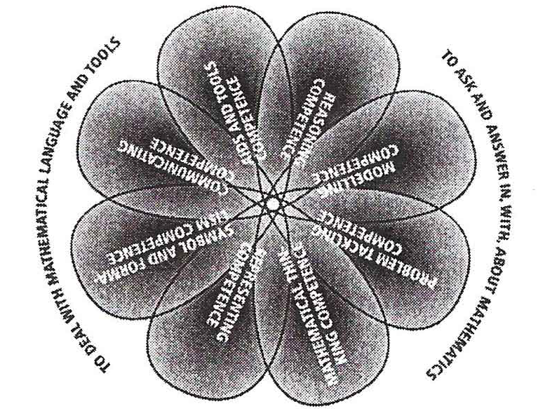
Modelling competencies in the KOM-project
Proposal by Niss (1999) for 8 mathematical competencies
KOM flower
Modelling competence as one component
Definition of competence as someone‘s insightful readiness to act in response to the challenges of a given situation
Specification of this construct as competency by Blomhøj & Jensen (2003, 2007) - analytical view in contrast to holistic view

Slide 29
Modelling cycle (Kaiser & Stender, 2013)
mathematise
Mathematical model
Real model
understand
simplify
Real situation
mathematical
work
validate
validate
Real results
Mathematical results
interpret

Slide 30
Description of modelling competencies along the modelling process with sub-competencies (Blum & Kaiser, 1997 and continuation by Maaß, 2004)
Competence to
understand the real problem
create a real model by simplifying the problem
and concentrating on questions that can be worked out;
recognising central variables and their relations;
formulating assumptions and descriptions of the problem
transfer the real model into a mathematical model
work mathematically within the mathematical model, i.e.
construct or select adequate mathematical models of the
problem and develop solutions from within the model;
interpret mathematical results in a real situation
evaluate the solution’s adequacy and validate it
Sub-process 1:
Understanding – Simplifying – Mathematising
Sub-process 2:
Working mathematically
Sub-process 3:
Interpreting – Validating

Slide 31
2. Promotion of modelling competencies

Slide 32
How can we promote modelling competencies in mathematics education?
Many important issues, in the following only a few key aspects selected.
Two different approaches of fostering mathematical modelling competencies:
holistic approach: the development of modelling competencies should be fostered by performing complete processes of mathematical modelling, whereby the complexity and difficulty of the problems should be matched to the competencies of the learners (Haines, Crouch & Fitzharris, 2003).
atomistic approach: propagates the individual fostering of sub-competencies of mathematical modelling, because implementation of complete modelling problems would be too time-consuming and be not effective (Blomhøj & Jensen, 2003).

Slide 33
Consequences for organising the inclusion modelling examples in schools – two extremes:
“mixing approach”, i.e. “in the teaching of mathematics, elements of applications and modelling are invoked to assist the introduction of mathematical concepts etc. Conversely, newly developed mathematical concepts, methods and results are activated towards applicational and modelling situations whenever possible” (Blum & Niss, 1991, p. 61).
“separation approach”, i.e. instead “of including modelling and applications work in the ordinary mathematics courses, such activities are cultivated in separate courses specially devoted to them” or variations like the “two-compartment approach” or the “islands approach” (Blum & Niss, 1991, p. 60)

Slide 34
Prologue by David Burghes Proceedings ICTMA 1, 1983, Exeter
„The basic philosophy behind the approach … of the modelling workshop for higher education is that to become proficient in modelling, you must fully experience it – it is no good just watching somebody else do it, or repeat what somebody else has done – you must experience it yourself. I would liken it to the activity of swimming. You can watch others swim, you can practice exercises, but to swim, you must be in the water doing it yourself.“
Similar positions:
Helmut Neunzert at ICTMA-14, 2009 in Hamburg: Modelling is not a spectator sport, in order to learn modelling, you have to model.

Slide 35
Authentic modelling problems in the context of modelling weeks in Hamburg
Project at Hamburg University since 2000 in cooperation by applied mathematics and mathematics education:
Modelling courses for students from upper secondary level (age 16-18) supervised by prospective teachers, twice a year with about 200-300 students from 21 higher level courses (years 11 and 12) from schools in Hamburg and surrounding and modelling days lasting three days with students from lower secondary level (grade 9, age 14) with whole age cohort of about 5-6 schools
Core: groups of students working on modelling problems

Slide 36
Characteristics of modelling activities
Teacher independent work on modelling examples by students necessary
No fast intervention by the teacher, only support in case mathematical means are missing or if the students are in a cul-de-sac regarding the content;
Experiencing of helplessness and insecurity a central aspect and a necessary phase.

Slide 37
Aims and characteristics of activities
Usage of authentic examples:
authentic examples (in the sense of Niss, 1998) are recognised by practitioner working in this field as examples they could meet;
only little simplified, often no solution known, neither to us nor to the problem poser;
often only problematic situation described, students have to determine or develop a question, which can be solved (Pollak, 1969: “here is a problem, think about it”);
various problem definitions and solutions possible dependent of norms of the modellers.
Aim is not: comprehensive overview on modelling approaches.

Slide 38
Characteristics of the examples and activities
No high level of mathematical knowledge expected, complexity from the context, making assumptions, simplifications, interpretations
Independent work is important
Challenge does not come from algorithms, but lies in the independent realisation of the modelling process

Slide 39
Problems of recent modelling activities
How can fishing be controlled sustainably by quotas?
When does an epidemic break out and how many people fall ill?
How can the arrangement of irrigation systems be planned in an optimal way?
How can we design an optimal wind park, off-shore or on-shore?
How can bush fires be hold off by cutting forest aisles?
In the following an advanced solution for this problem, can be done more elementarily by students at school or at university.

Slide 40
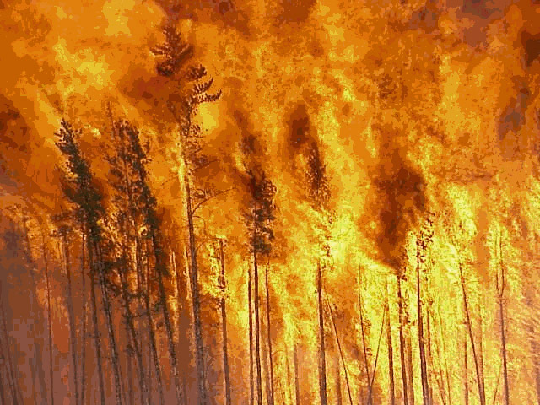
How can bush fires be hold off by cutting lanes?
Bush fires are a serious problem for large connected wooded areas.
Therefore it is important to raise questions about prevention and containment of bush fires.
Methods like forest aisles or the controlled burning off of single forest areas can constitute effective measures.
Construct a preventive model for bush fires while cutting down as many trees as necessary but as few as possible!

Slide 41
Simplify the situation, idealise and structure - Real model -
Assumptions:
quadratic forest area (commercial forest)
parallel forest aisles with a fixed width (e. g. 5m)
Forest aisles are equidistant
the fire cannot skip over an aisle
no wind
the fire breaks out only in one separate forest area at one time
if no additional forest aisles will be cut in the area, where the fire breaks out, this whole forest area will burn down

Slide 42
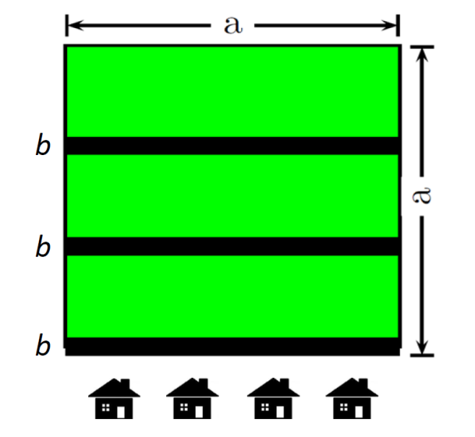
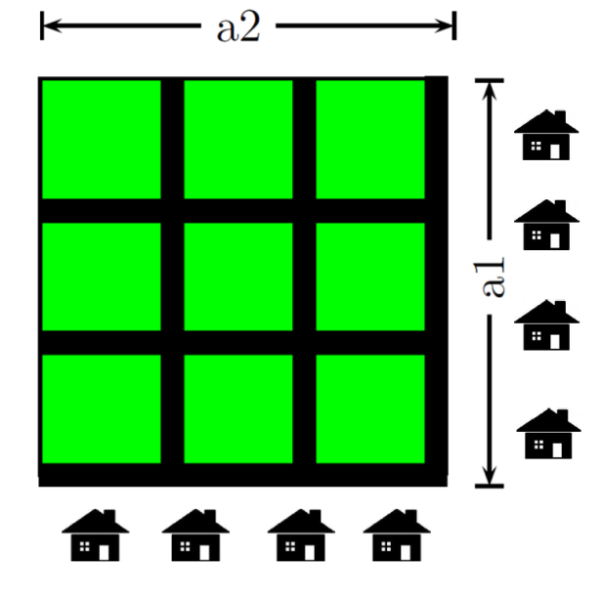
Mathematise the real model - Mathematical model –
First mathematical model
Further mathematical model

Slide 43
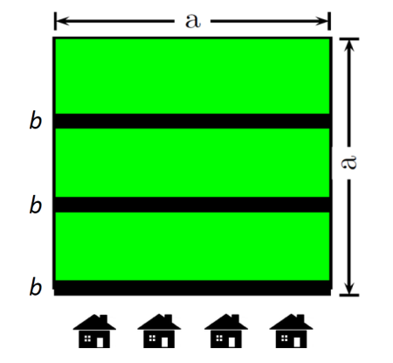
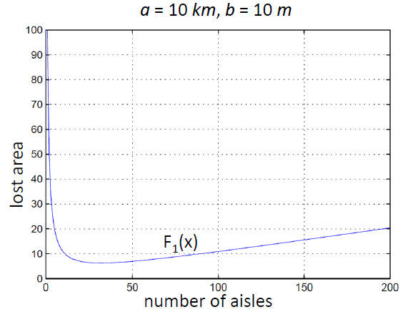
Mathematical work and results
In the first mathematical model:
lost forest area (by deforestation and fire):
$x$ : number of aisles
for example a = 10 km and b = 10 m:
$$F_{1}\left(x\right)=abx+a\left(\frac{a}{x}−b\right)=\frac{abx^{2}−abx+a^{2}}{x}$$
$F_{1}^{′}\left(x\right)=ab−\frac{a^{2}}{x^{2}} \text{⇒}{ F}_{1}^{′}\left(x\right)=0$ ⇒$x_{0}=\sqrt{\frac{a}{b}}$
$x=\sqrt{\frac{10}{0.01}}≈31.62$ ⇒ $F_{1}^{}\left(31\right)≈6.23 {km}^{2}$

Slide 44
Mathematical work and mathematical results
In the further mathematical model:
lost forest area (by deforestation and fire):
$x$ : aisles vertical, $y$ : aisles horizontal
for example a = 10 km and b = 10 m:
$x_{0}=y_{0}=10$⇒${ F}_{2}\left(10.10\right)=2.97{ km}^{2}$
$${ F}_{2}\left(x,y\right)=\left(ba_{2}x+ba_{2}y−b^{2}xy\right)+\left(\frac{a_{1}}{x}−b\right)\left(\frac{a_{2}}{y}−b\right)$$
$∇F_{2}\left(x,y\right)=0$⇒ $x_{0}=\sqrt[3]{\frac{a_{1}^{2}}{a_{2}b}}$ and $y_{0}=\sqrt[3]{\frac{a_{2}^{2}}{a_{1}b}}$

Slide 45
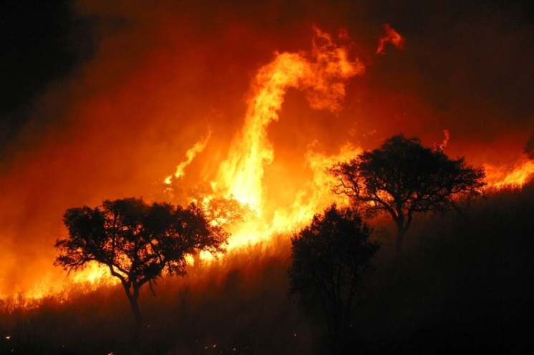
Interpretation of the mathematical results - Real results –
The lost forest area in the further mathematical model is lower (about 2.97 km² instead of 6.23 km²) and only 20 aisles are needed instead of 31 in the first mathematical model
Validate the results and improve the model:
Consider wind and its direction
Dynamic of a bush fire
cellular automata

Slide 46
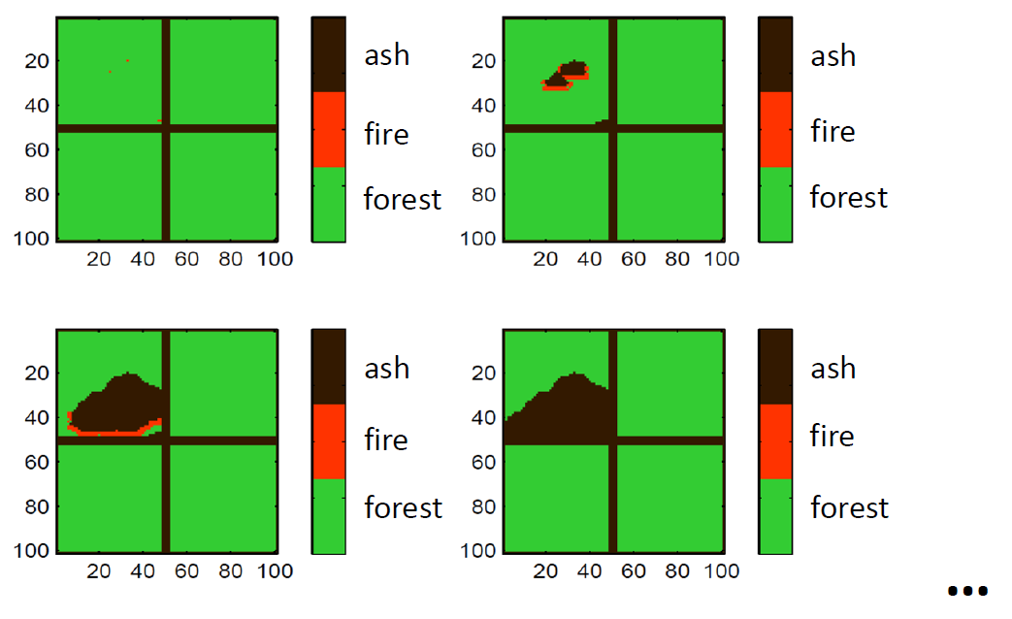
Advanced mathematical model
cellular automata:
programming the dynamic of a bush fire via simulation with fixed parameter for wind direction, wind strength ……

Slide 47
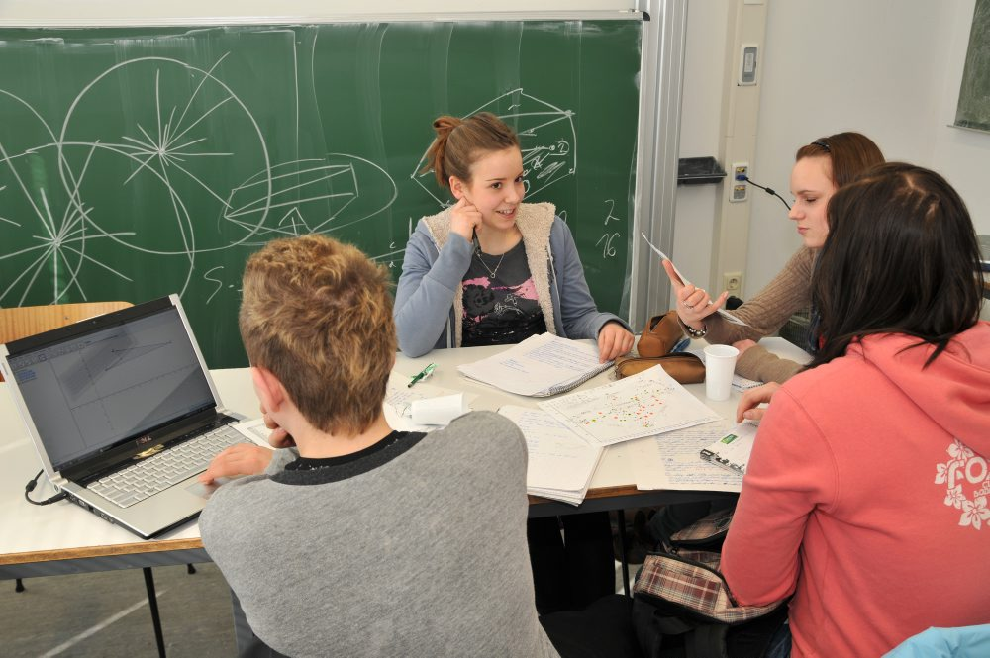
Characteristical activities within our modelling activities with students
Peer-explanations by students
Work in groups with minimal help by tutors

Slide 48
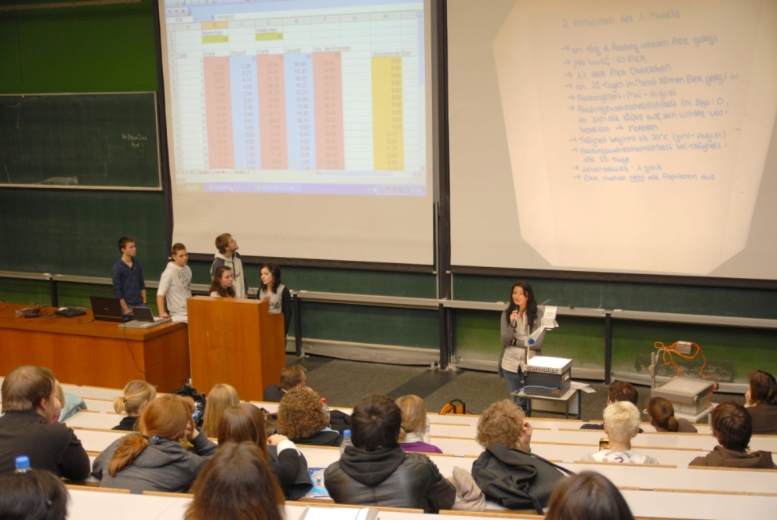
Characteristical activities within our modelling activities with students
Presentation of results by students in lecture hall
Presentation of results via poster exhibition

Slide 49
Modelling „recommendations“ developed from practical implementation
Define real problem as precise as possible.
Clarify the necessary information, are they already given, where to get further information or do we have too much information?
Develop the mathematical question as precise as possible, if necessary develop several questions.
Simplify radically at the beginning the question to tackle, if necessary stepwise enrichment of the model.
Based on common problem of novices: try to include as many variables as possible, drown in them.

Slide 50
Selected results of empirical studies
Evaluation of different modelling activities with different instruments taken from the literature
Evaluation of modelling competencies with the test instrument developed by Haines et al.
In more recent activities by Susanne Brand (submitted PhD thesis): comparison of efficiency of holistic and atomistic approach with an own modelling test developed

Slide 51
Summary of these evaluation results
Modelling competencies of students can be promoted in school by adequate courses, either within ordinary classroom setting or special modelling weeks, strong increase in competencies
But: somehow instable progress, decrease after some time, if no further activities are following; apparently longitudinal processes within whole curriculum change necessary.
Different progress within sub-competencies dependent of approach used, but no strong advantage or disadvantage of atomistic or holistic approach.
Conclusions: long-term processes necessary with integrated approach, i.e. atomistic and holistic phases.

Slide 52
Evaluation of students‘ reactions
Questionnaire with open items used in many empirical studies
289 students from recent modelling week participated

Slide 53
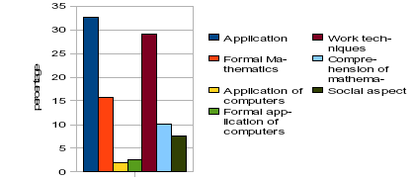
“From your point of view, what did you learn when dealing with the modelling example?”
71% of the students answered positively, only 12% did not see any learning outcomes from the modelling week.

Slide 54
Students‘ voices
“…that mathematics not only can be applied in school, but also to specific examples in real life.” (Female student, 19 years old)
“…that mathematics can also be applied to things in everyday life.” (Male student, 17 years old)
“…to solve arising problems autonomously.” (Female student, 16 years old)

Slide 55
“Should these examples be increasingly dealt with as part of regular maths classes or would you reject this?”
“I think that these examples should DEFINITELY be dealt with in maths classes. Because of these examples one will only realise what mathematics is needed for.” (Male student, 16 years old)
“I think so, because it illustrates the importance of mathematics for everyday life.” (Male student, 16 years old)
“Such problems SHOULD be dealt with in class, because they will improve the so-called ‘competence in problem solving’. Furthermore, it will train the knowledge gained in previous grades.” (Male student, 19 years old)

Slide 56
3. Related approaches: mathematical literacy and numeracy

Slide 57
Similar approach for mathematics education within OECD-PISA study based on the concept of mathematical literacy.
„Mathematical literacy is defined as the capacity to identify, understand and engage in mathematics, and to make well-founded judgements about the role that mathematics plays in an individual‘s current and future private life, occupational life, social life with peers and relatives, and life as constructive, concerned and reflective citizen. …, the definition revolves around the wider uses of mathematics in people‘s lives rather than being limited to mechanical operations. ….
Mathematical literacy also implies the ability to pose and solve mathematical problems in a variety of situations, as well as the inclination to do so, which often relies on personal traits such as self-confidence and curiosity.“

Slide 58
Similar approach: Numeracy
“Numeracy is increasingly seen as fundamental to developing students’ capacities to use mathematics to function as informed and reflective citizens, to contribute to society through paid work, and in other aspects of community life” (Steen, 2001).
An Australian definition of numeracy (AAMT, 1997):
“To be numerate is to use mathematics effectively to meet the general demands of life at home, in paid work, and for participation in community and civic life.”

Slide 59
Distinguishing numeracy from mathematics and modelling
Mathematics is characterised by abstraction, aims for general patterns
Modelling aims for more than specific solutions, development of general models, which can be used in several situations, not useful mathematics
Numeracy is context-bound, relies on specific methods, quite often rule of thumbs or personally developed approaches.

Slide 60
Numeracy is an across the curriculum commitment
Australian National Numeracy Review (2008, p. 7) :
“That all systems and schools recognise that, while mathematics can be taught in the context of mathematics lessons, the development of numeracy requires experience in the use of mathematics beyond the mathematics classroom, and hence requires an across the curriculum commitment.”
Consequently: Numeracy as a General Capability in the Australian Curriculum
Large ongoing promotion projects, e.g. by Dole, Forgasz, Geiger, Goos

Slide 61
Important questions for next conference :
How far are numeracy or mathematical literacy adequate didactical approaches for preparing for the future?
How can modelling activities for preparing for the future look like?

Slide 62
To summarise:
Modelling as an established didactical approach can offer many examples for emergency preparedness;
But not only examples are important, but also ways of fostering it.
If students shall really be prepared for emergency cases:
they need to carry out modelling processes by themselves (not a spectator sport)
they need to take the examples seriously, authentic examples are necessary, which contain a serious problem to be posed or question to be anwered.

Slide 63
Thank you very much for your attention.

